Slide 1
Medical X-ray Image Classification Employing DCGAN and CNN Transfer Learning Techniques
PRESENTED BY
md. Asif Talukdar

Slide 2
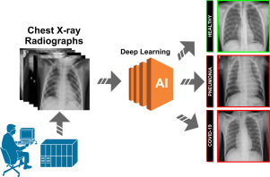
Problem statement and solution
pneumonia got major heed because of its intensity
doctors rely on the chest X-Ray to diagnose the disease
Use of CNN on X-ray images to discern pneumonia
Source: https://www.sciencedirect.com/science/article/pii/S156849462101036X

Slide 3
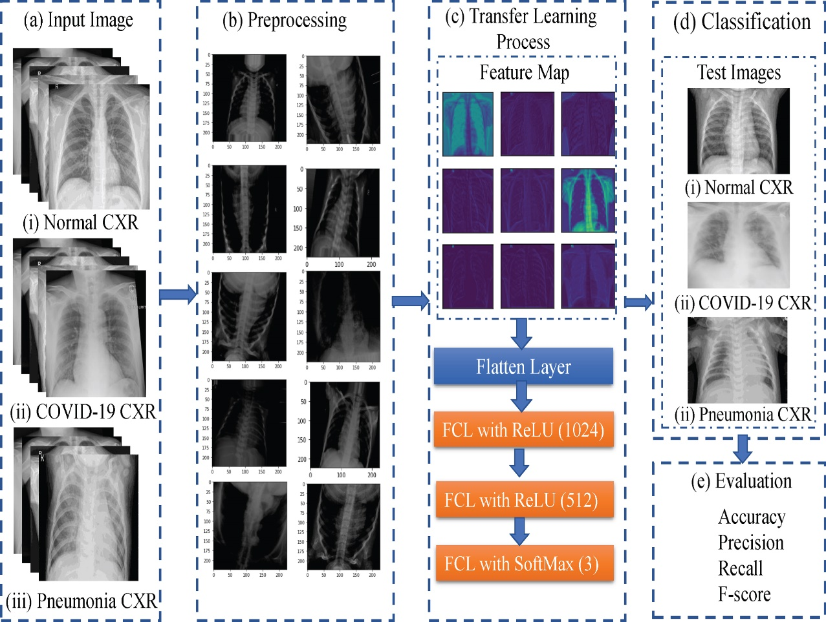
Usual method of discerning the disease with CNN
Data preparation
Data Pre-processing
Train test split
Feed the training dataset to CNN architectures/models
Testing the obtained result
Compare the result with evaluation metrics
Source: https://content.iospress.com/articles/journal-of-x-ray-science-and-technology/xst200715

Slide 4
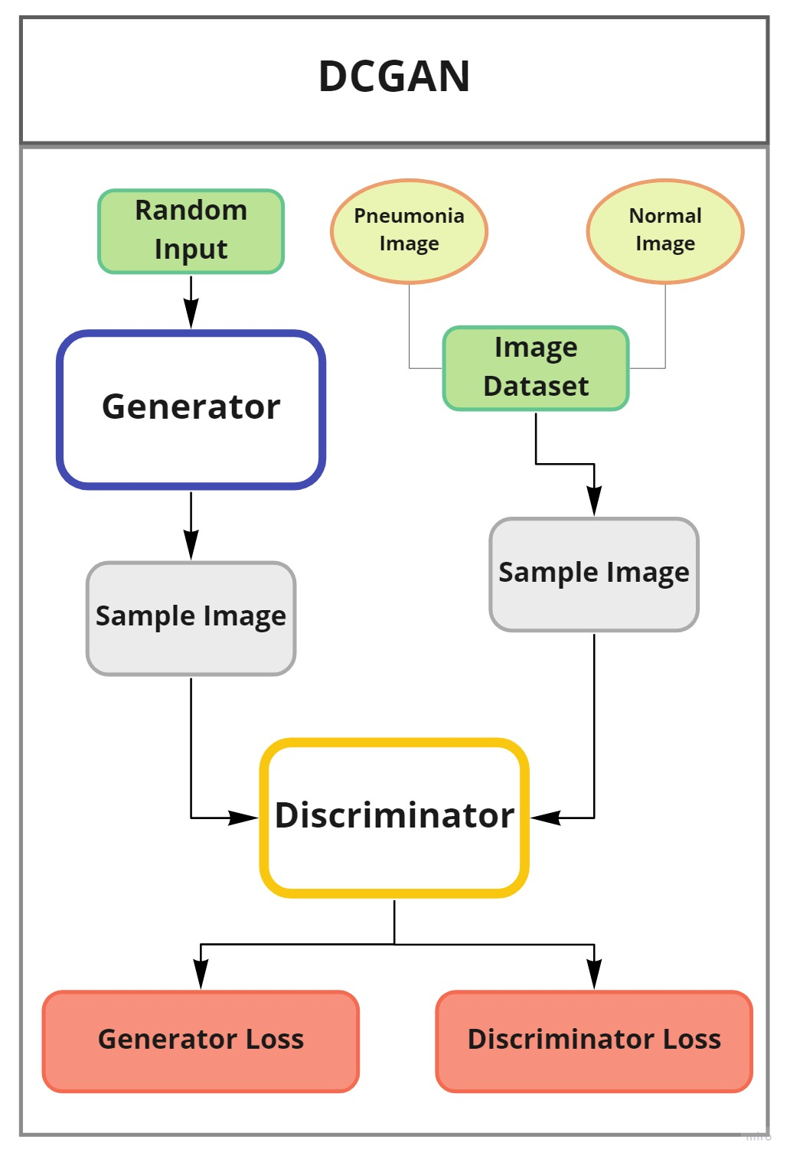
We implemented Deep Convolutional GAN (generative adversarial network)
Generator, also known as Artist, and
Discriminator, also known as the Critic
It captures the pattern and created data from exiting data

Slide 5
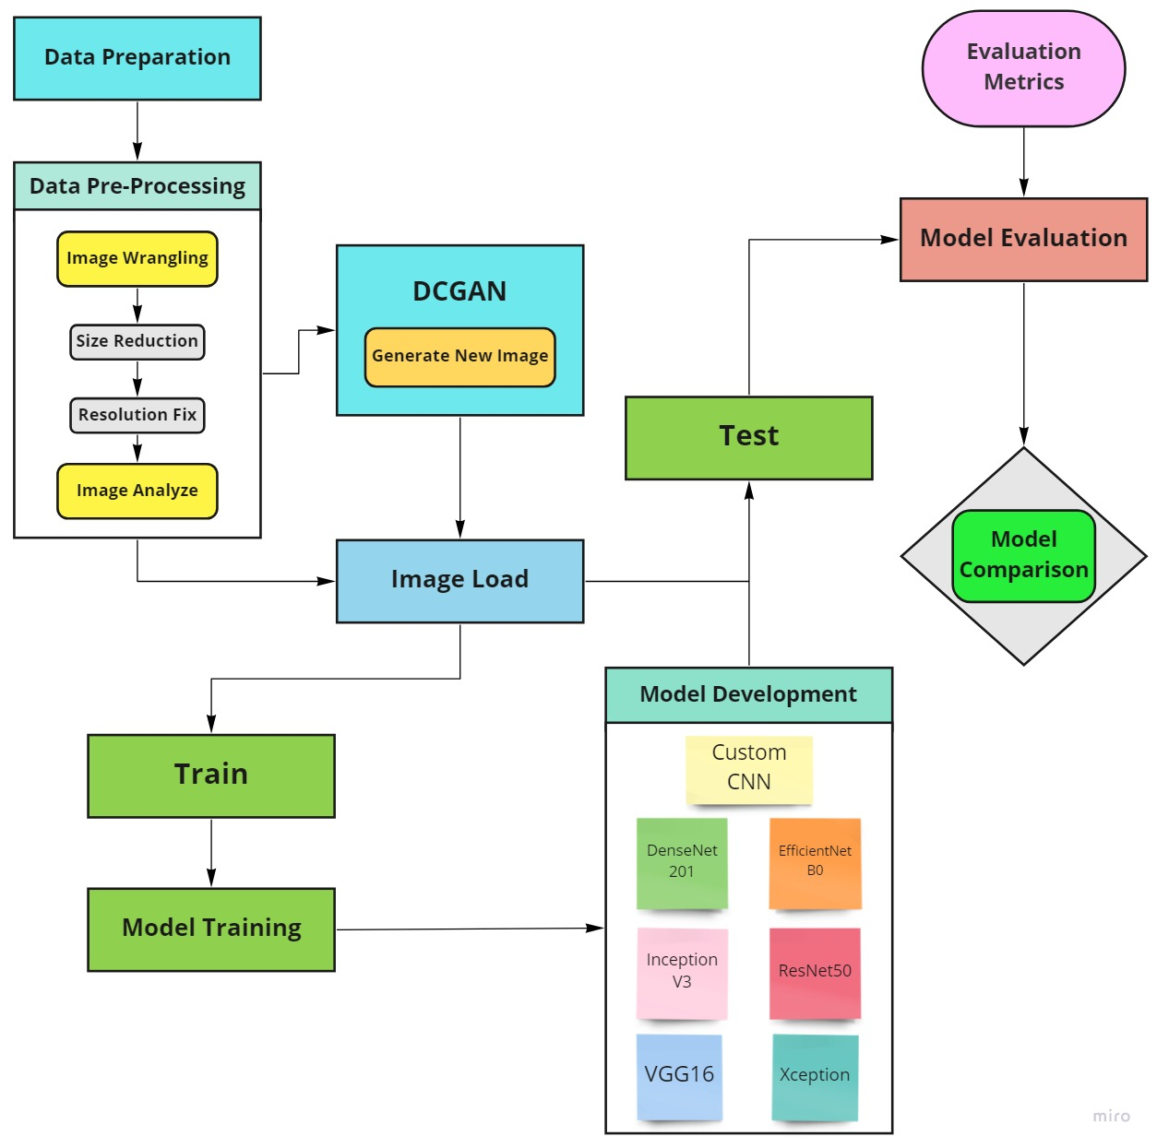
Workflow Diagram
Models used:
Custom CNN
DenseNet 201
InceptionV3,
ResNet50,
EfficientNetB0,
VGG16,
and Xception.

Slide 6
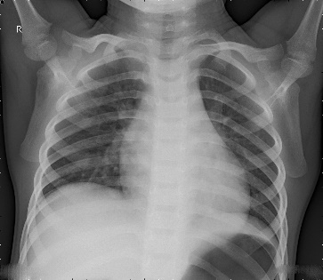

Data Acquisition and Pre-Processing
Dataset from Kaggle
Dataset was divided and stratified into a 80% training set and 20% test set
5856 images (73% pneumonia and 27% normal)
150-epoch approach to generate 1500 synthetic pneumonia
100-epoch approach to generate 1000 synthetic normal image
Lastly 7% of the newly generated synthetic images were selected.
Image from dataset and created synthetic data using DCGAN (100 epoch)

Slide 7
Previous notable works
Ayan et al. [1] worked on vgg16 and Xception, showed that vgg16 performs better for detecting the typical case, and on the other hand, Xception performs better for the detection of pneumonia, and the combination of both will be more accurate.
Rod´rıguez et al. [3] used a neuroevolution algorithm based on Particle Swarm Optimization for the construction and training of GANs to develop biomedical Chest X-Ray (CXR) pictures of pneumonia.
Srivastav et al. [2] trained deep convolutional generative adversarial networks(DCGAN) to supplement synthetic images and oversample the dataset, therefore, used VGG16 and transfer learning was applied with convolutional neural networks(CNN). On the validation set, the model had a 94.5% accuracy rate
Ayan E, Unver H (2019) Diagnosis of Pneumonia from Chest X-Ray Images Using Deep Learning. 2019 Scientific Meeting on Electrical-Electronics Biomedical Engineering and Computer Science (EBBT). doi: 10.1109/ebbt.2019.8741582
Srivastav D, Bajpai A, Srivastava P (2021) Improved Classification for Pneumonia Detection using Transfer Learning with GAN based Synthetic Image Augmentation. 2021 11th International Conference on Cloud Computing, Data Science Engineering (Confluence). doi: 10.1109/confluence51648.2021.9377062
Rodriguez-de-la-Cruz J, Acosta-Mesa H, Mezura-Montes E (2021) Evolution of Generative Adversarial Networks Using PSO for Synthesis of COVID-19 Chest X-ray Images. 2021 IEEE Congress on Evolutionary Computation (CEC). doi: 10.1109/cec45853.2021.9504743

Slide 8
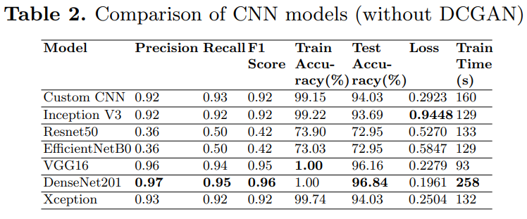

Slide 9
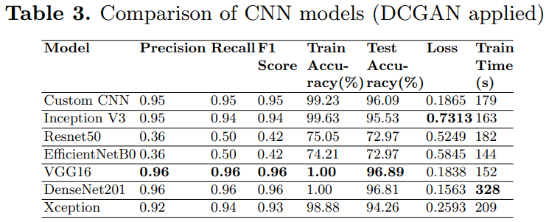
Custom CNN, VGG16 and DenseNet201 are the most accurate of the all methods, exception Densenet201

Slide 10
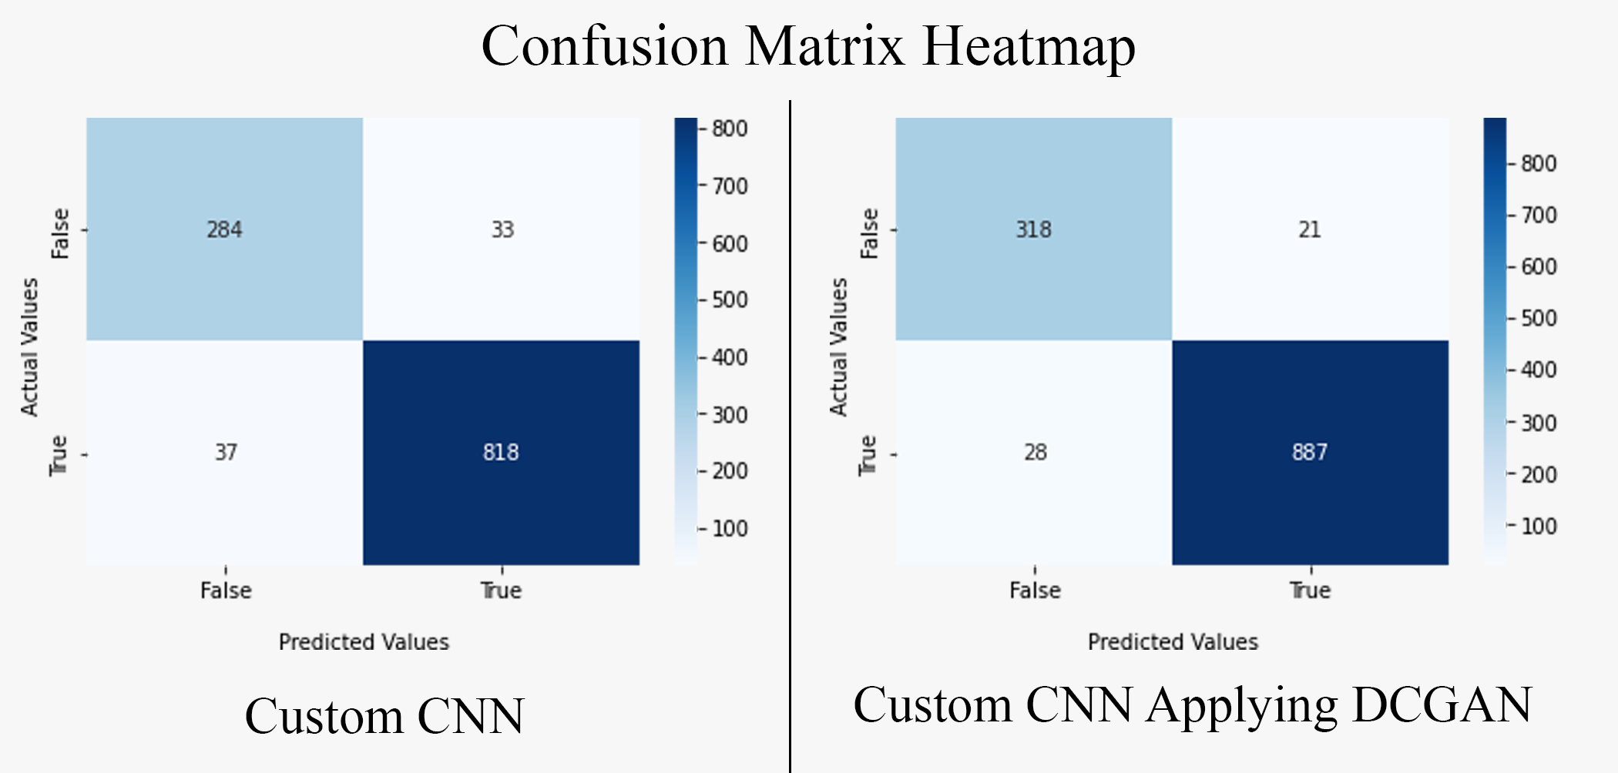

Slide 11
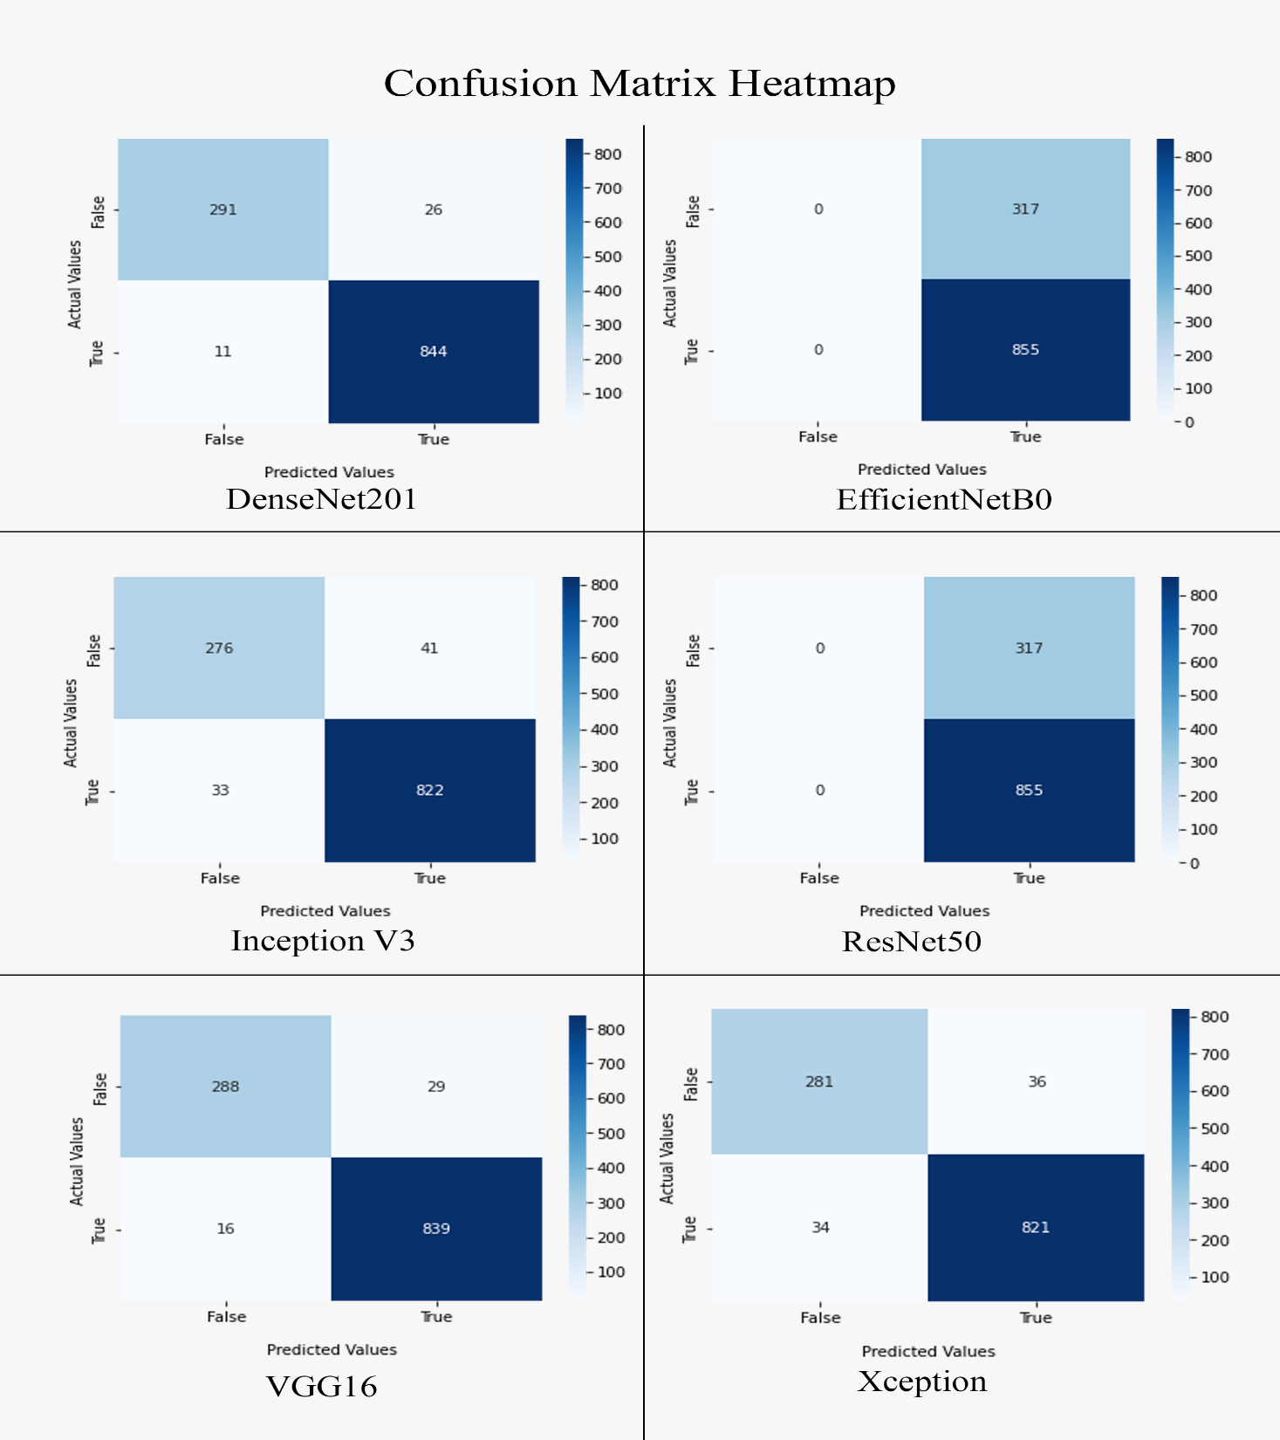
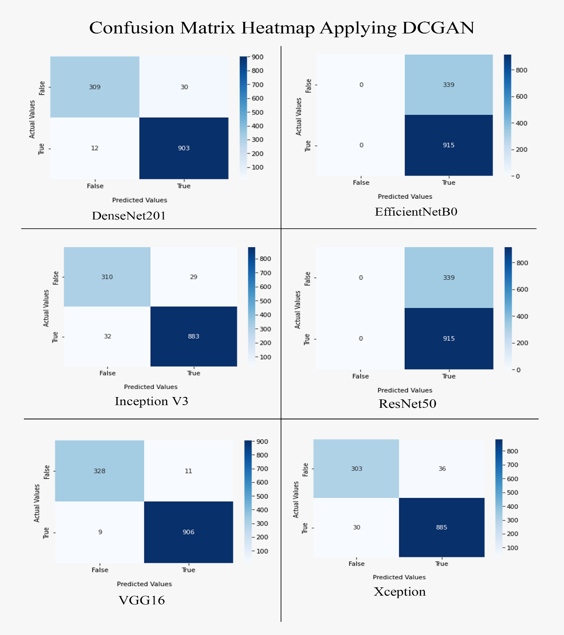

Slide 12
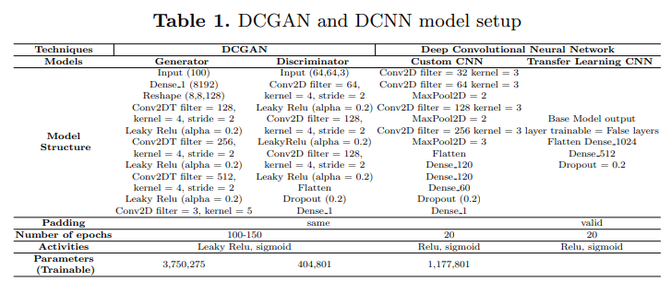

Slide 13
Limitation and Future works
Scarcity of resources during covid time
Lack of expert supervision

Slide 14
Thank You

